Slide 1


Maheshkumar R
Cloud Solution Architect
MahesKBlr
Notes:
Hello and thank you all very much for taking the time to join today.
Personal Intro

Slide 2
GitHub Copilot
Practical Use Cases for AI Pair Programming
Code faster with code suggestions
Code to Comment
Improve code
syntax quality
Write Test Cases
Understand & Convert Code
Prevent Common Vulnerabilities

Slide 3
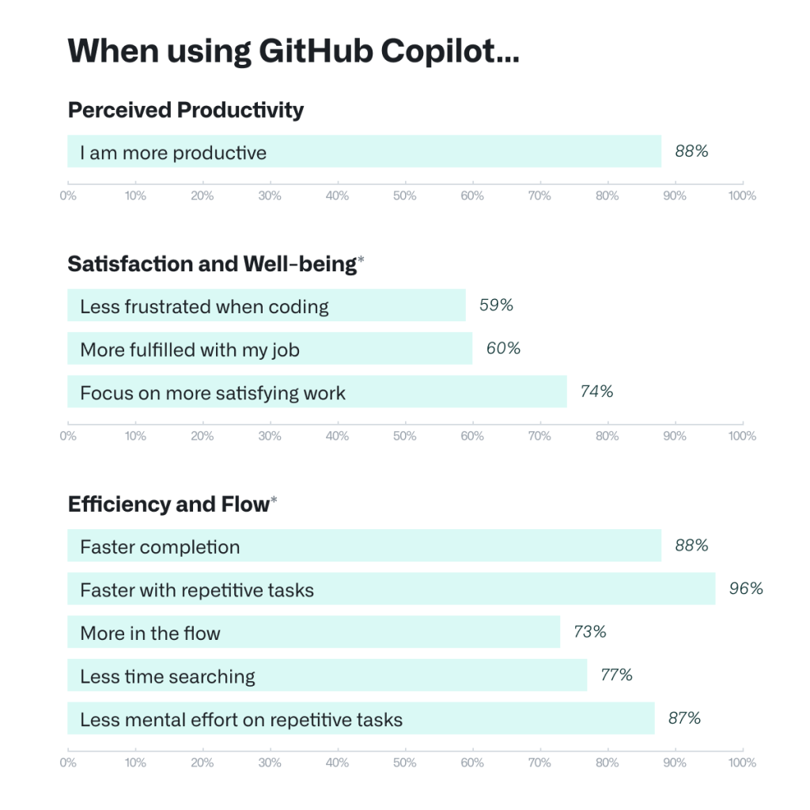
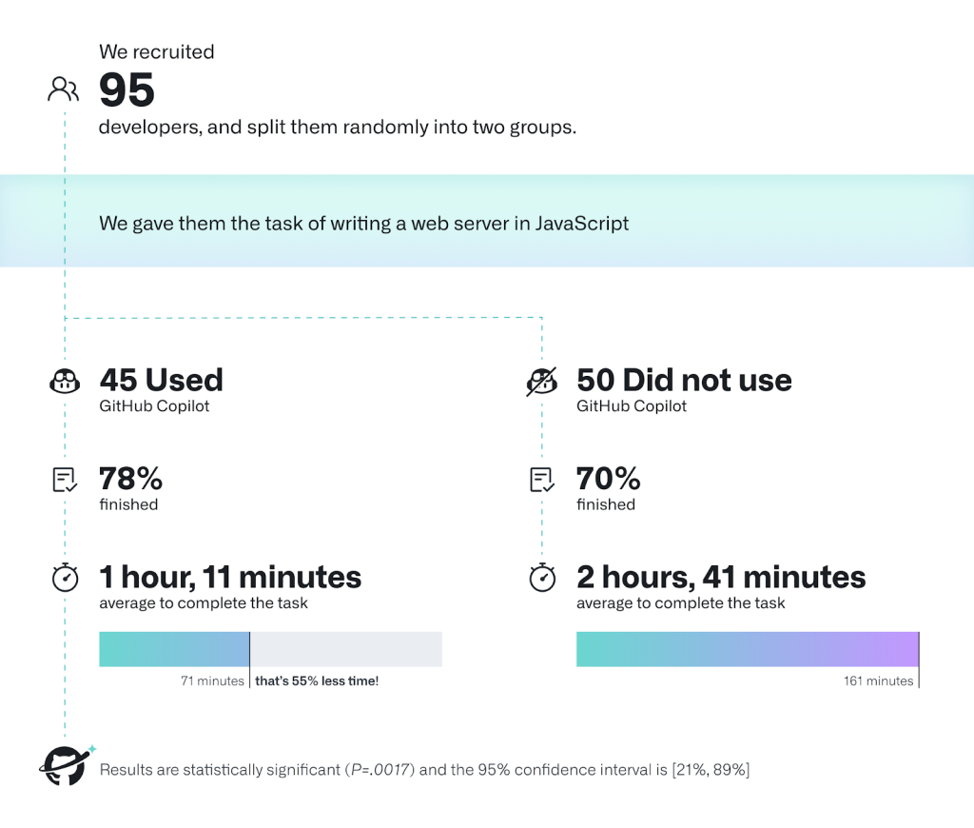
Developer productivity when using GitHub Copilot
Notes:
So these are some of the top most custom software development challenges. When we did a sample scenario of GitHub copilot, we picked up some 95 people randomly broke them into two teams and we asked them to build writing a web server using JavaScript and half of them who did not use GitHub copilot too close to three hours and the other hub who used copilot, they took close to.
One hour. So there was a significant proven improvement on this speed and velocity and quality, but that's just not the one. Productivity is not the only factor. We've also seen significant improvement on their satisfaction on their well-being, how how much it helps them to get into the flow and hence be very effective and efficient.

Slide 4
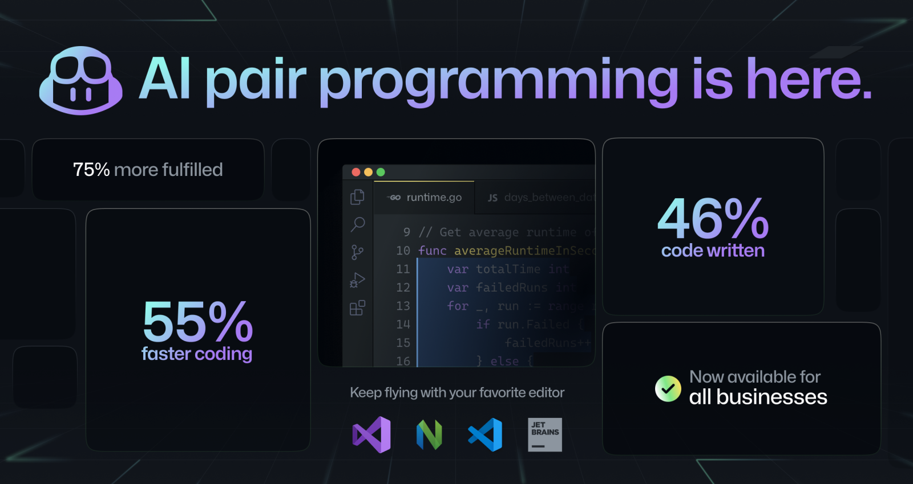


Slide 5
Most pressing challenges for software developers
Software System Complexity
Meeting Deadlines
Keeping up with new technologies
Managing changing requirements
Maintaining Quality
Collaboration
Debugging
Building Robust Architecture
Dealing with legacy code
Managing complexity in distributed development

Slide 6
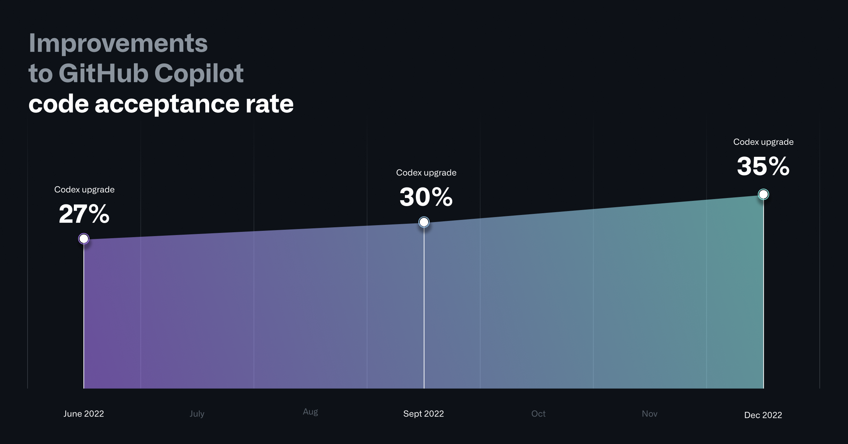
Today, GitHub Copilot is behind an average of 46% of a developers’ code across all programming languages—and in Java, that number jumps to 61%.
Notes:
There might be more on the roadmap that is coming, but this alone is significantly helpful and to give you an example we are updating this Codex engine and publishing it almost every quarter and with every update.
Which we did in June, September and December, the acceptance rate is going up and for the developer who are already using GitHub today, if you see for the existing user close to half of their code base has been written by GitHub and for Java developers, the rate is even higher, almost 60% of their source code base has been written by copilot. So that speaks volumes about the contribution of this product. Developer productivity. Now let me give you a demo and.

Slide 7
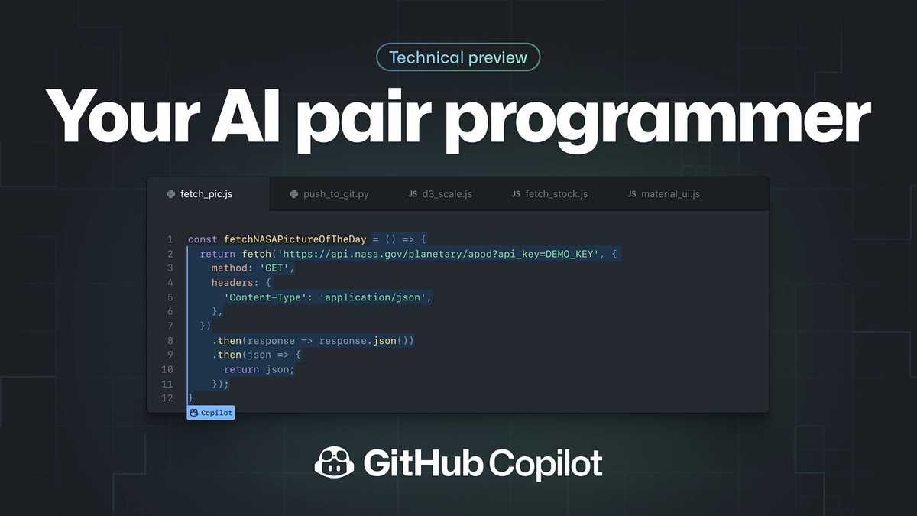
Demo 1

Slide 8


Add a body to our web site

Slide 9
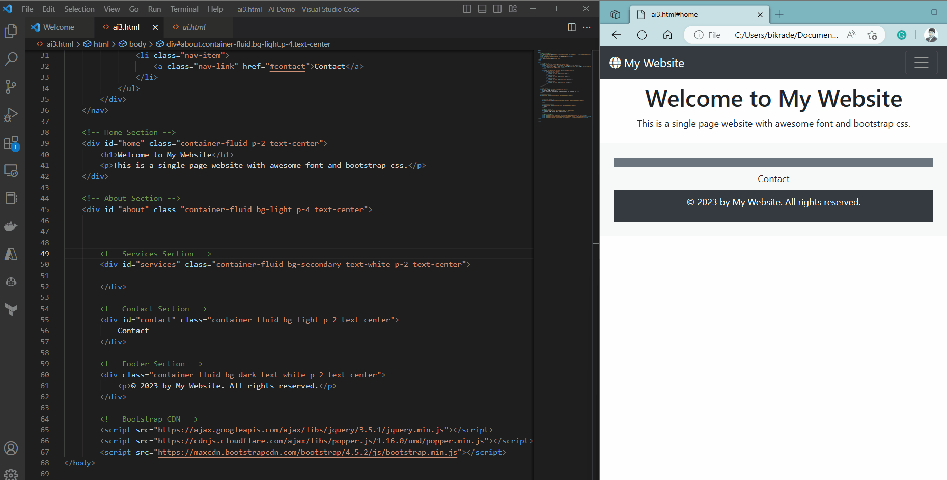
We are going to build the website body – with Copilot!

Slide 10
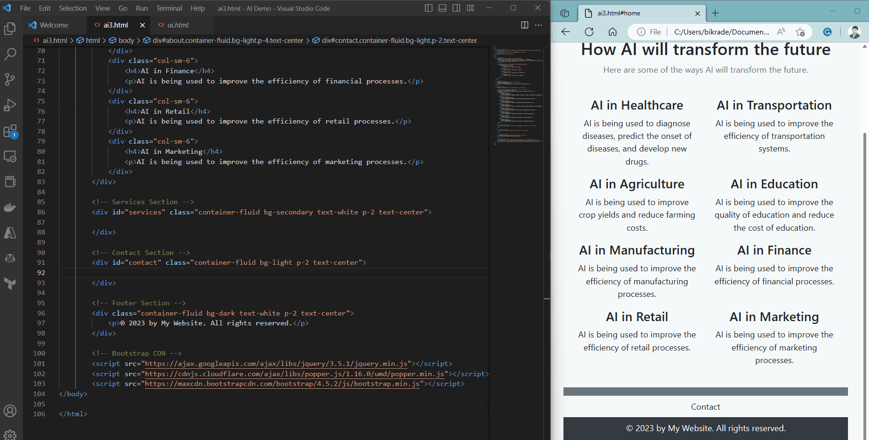
Let’s add some video to the website – with Copilot!
Add a video

Slide 11
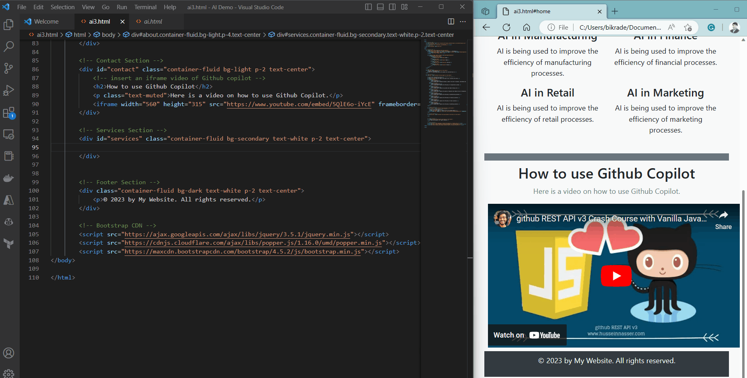
Let’s add a Services section - Copilot understands the context!
Add service offerings

Slide 12
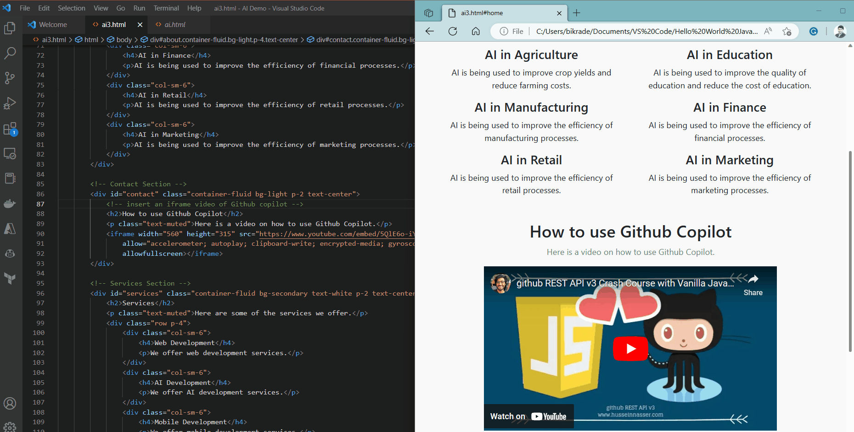
Let’s add one last thing …
Add an interactive button

Slide 13
Demo 2

Slide 14
Modify the page design

Slide 15
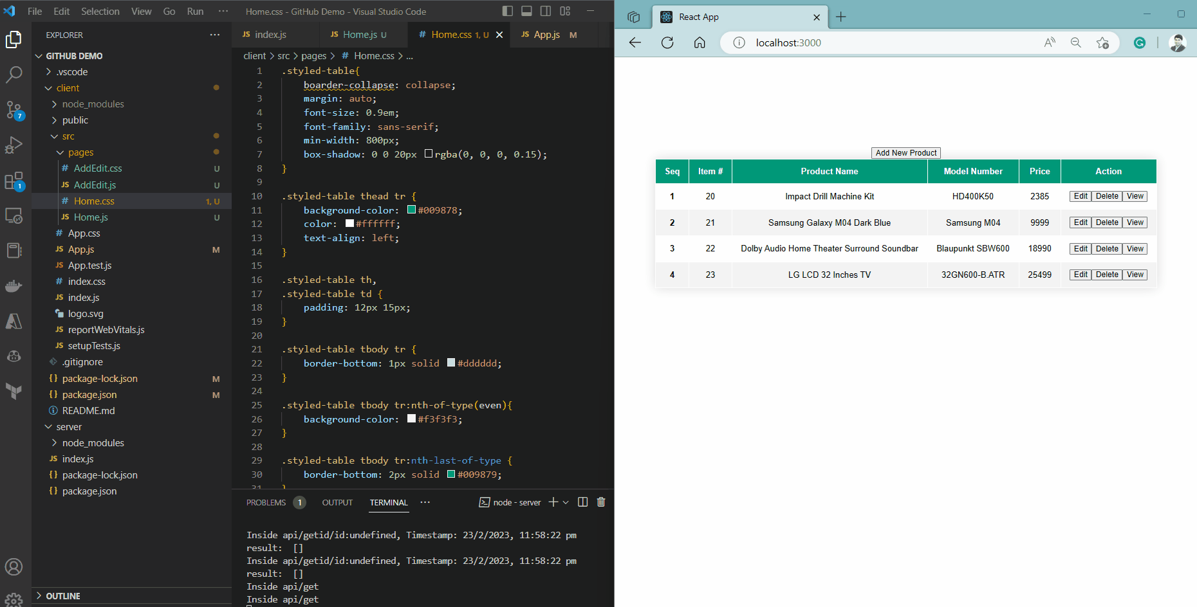
Let’s use Copilot to edit the design of Product App

Slide 16
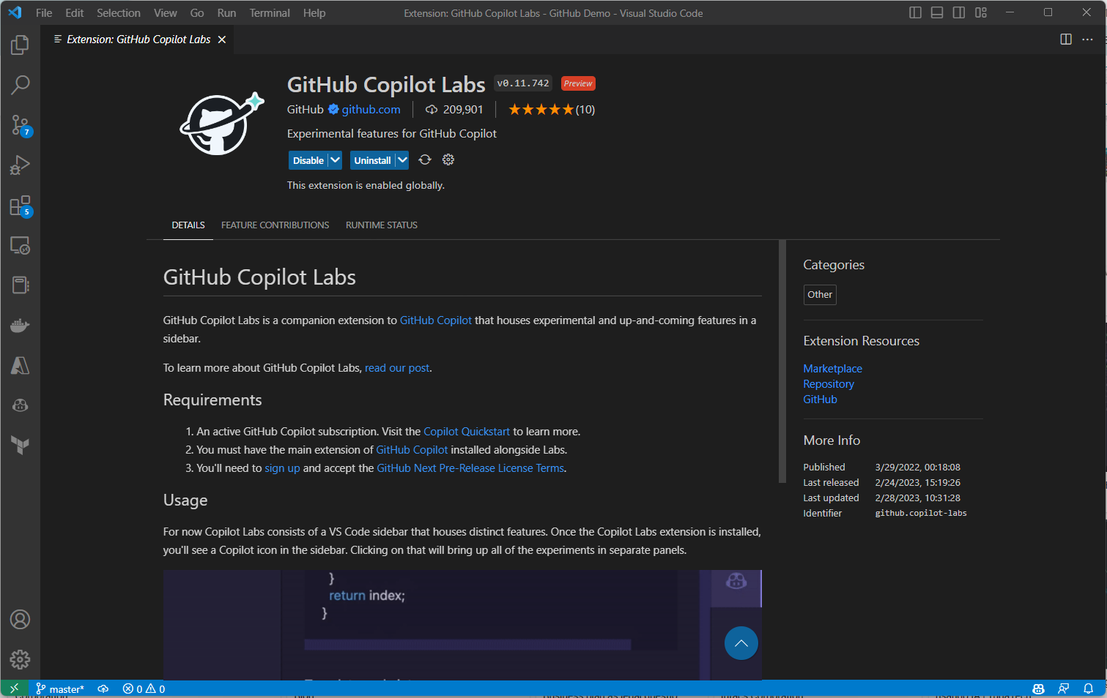
GitHub Copilot Labs
A VS Code extension for experimental applications of GitHub Copilot

Slide 17
Understand code & add better comments

Slide 18
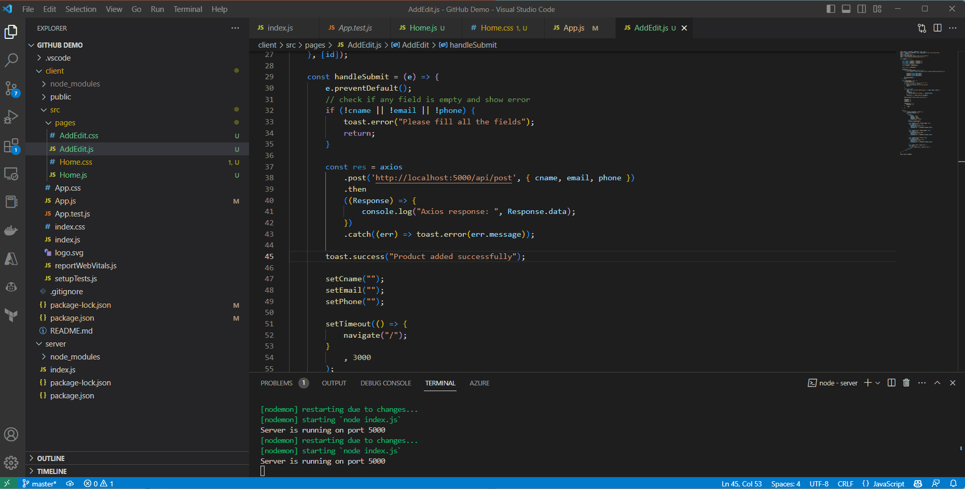
Let’s use Copilot to understand and add better comments …

Slide 19
Generate Unit Test cases

Slide 20
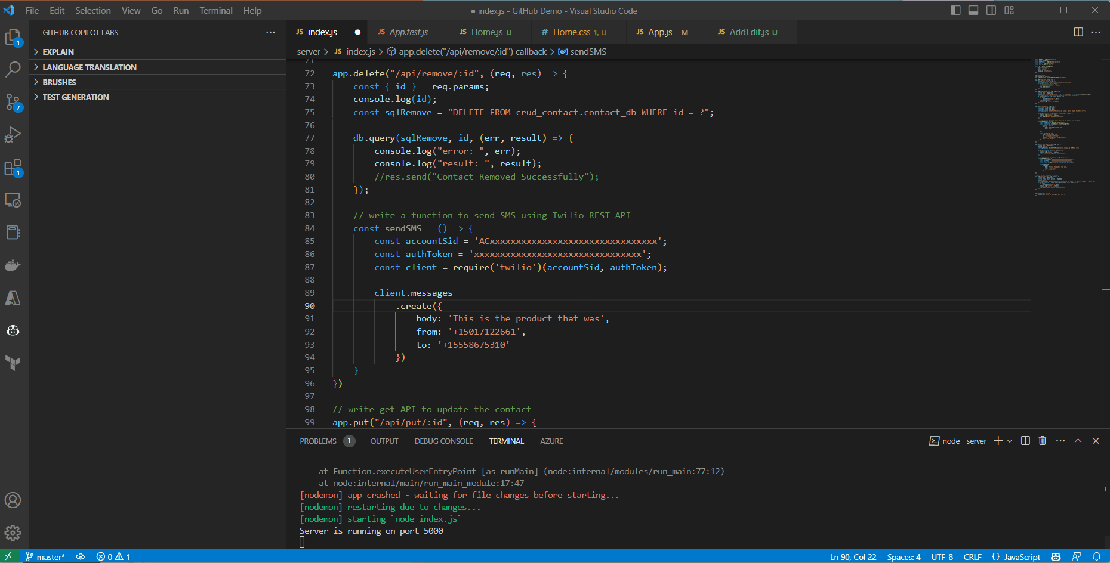
Generate test cases using Copilot

Slide 21
Translate the code

Slide 22
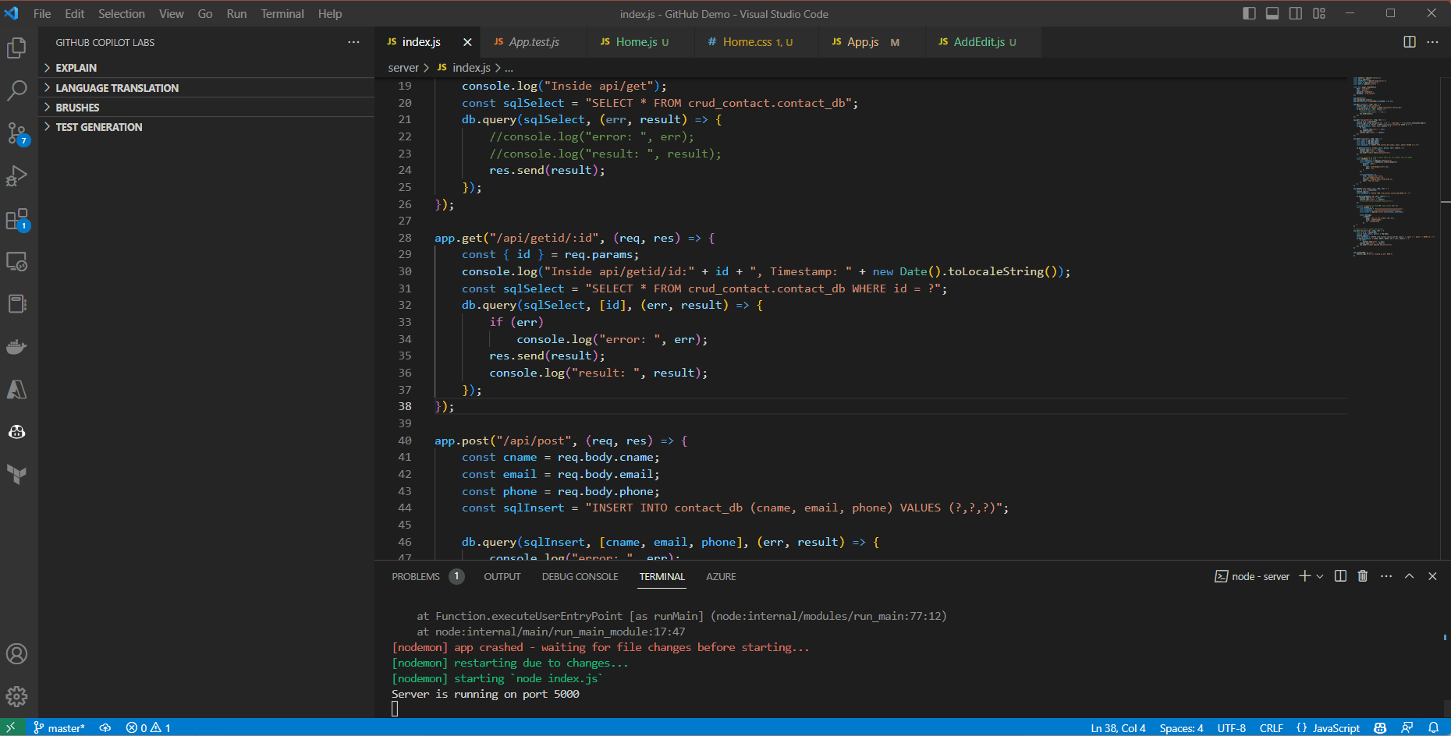
Translate code from one language to another language

Slide 23
Make the code robust, or fix bugs

Slide 24
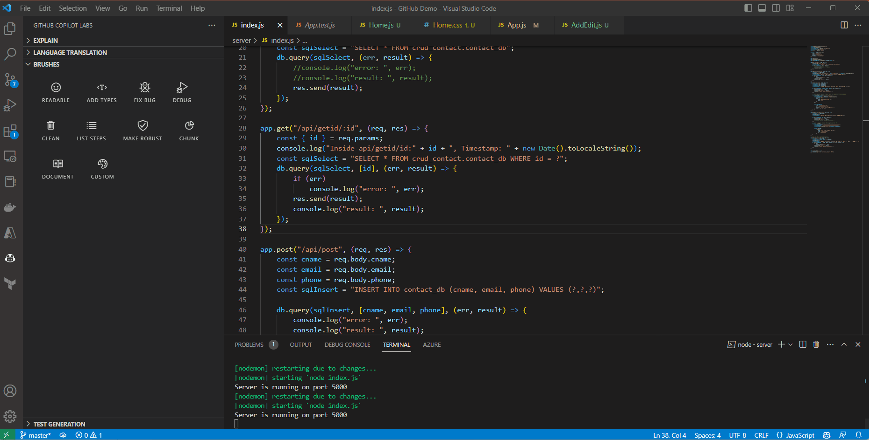
Apply more brushes …

Slide 25
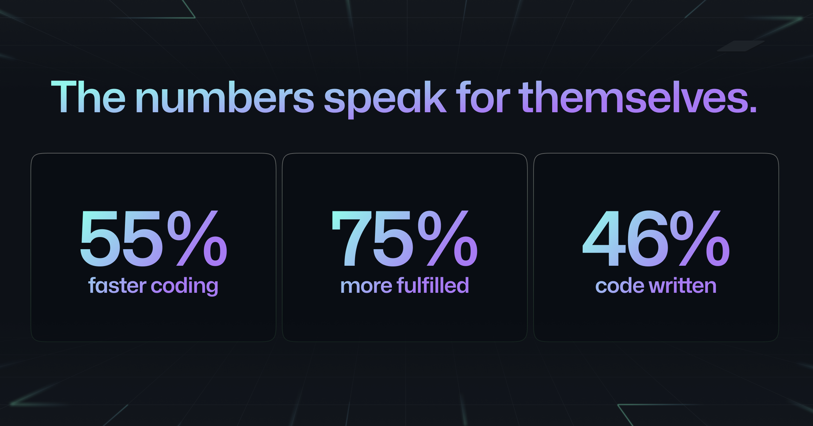
FAQ
ROI and Business Benefits
GitHub does not own the suggestions
Suggestions are generated by AI in a probabilistic way, not copied from snippets
Copilot collect 2 data points – user interaction data with IDE, and code snippet (code snippet are not retained)
The transmitted data is encrypted in transit and at rest – they are secured
Copilot does not share your private code as suggested code to other users, and do not use your private code to train CODEX model
Our modelling* shown 50-70X financial ROI in Copilot investment for software engineering projects
Copilot helps to free up 10-15% of invested capital on engineering team by speeding up MVP delivery timelines, accelerating developer velocity & learning, and reducing software quality issues
* Modelling done for 25-member software development team, over a 6-month project

